Slide 1
Autonomous Traffic Flow Control through V2X Communication: A Research Study

Slide 2
review
Project Guide:
Dr. A. Jackulin Mahariba
Assistant Professor (101370)
Project Team Members:
Aditya Chaturvedi (RA2011033010012)
Pratham Sahu (RA2011033010031)

Slide 3
ABSTRACT
In the ever-evolving landscape of urban mobility, the amalgamation of autonomous technologies and Vehicle-to-Everything (V2X) communication emerges as a transformative force in refining traffic flow dynamics. This research undertakes a systematic exploration, centring on the development of a robust theoretical model and innovative algorithmic frameworks aimed at autonomous traffic management. The core objective is to create a theoretical foundation that can seamlessly integrate with cutting-edge V2X communication, fostering an environment where vehicles communicate not only with each other but also with the surrounding infrastructure. By harnessing the power of autonomous technologies, the goal is to enhance traffic coordination, reduce congestion, and improve overall road safety. Through meticulous simulation-based analyses, the research assesses the adaptability and performance of the proposed system within dynamic traffic scenarios. This involves considering various factors such as real-time data exchange, predictive analytics, and responsiveness to unforeseen events. The simulations provide a valuable testing ground to validate the effectiveness and efficiency of the theoretical model in real-world applications. Ethical considerations, data privacy intricacies, and broader societal implications are integral components of this study. As we venture into an era where vehicles communicate seamlessly with each other and their surroundings, it is imperative to address ethical and privacy concerns to ensure the responsible and secure implementation of these technologies. This research contributes nuanced insights to the ongoing discourse on intelligent traffic control systems. The findings and strategic recommendations aim to propel the development and implementation of sophisticated traffic management solutions, fostering a safer, more optimized, and ethically sound urban mobility ecosystem. The ultimate aspiration is to pave the way for a future where autonomous technologies and V2X communication collaboratively redefine the dynamics of urban transportation.

Slide 4
INTRODUCTION
Urbanization Challenges: Addressing the complexities arising from rapid urban growth and increased traffic congestion in evolving cities.
Autonomous Mobility: Exploring the transformative impact of autonomous vehicles on reshaping transportation dynamics.
V2X Communication Integration: Unravelling the potential of Vehicle-to-Everything (V2X) communication as a dynamic layer in urban infrastructure.
Intelligent Traffic Orchestration: Envisioning a future where autonomous vehicles, coupled with V2X, intelligently coordinate to optimize urban traffic flow.
Technological Revolution: Embracing the synergy of autonomy and communication as a revolutionary approach to urban mobility challenges.

Slide 5
MOTIVATION
Transportation Transformation The project responds to the evolving transportation landscape, driven by the integration of autonomous driving and advanced V2X communication technologies.
Realizing V2X Benefits Recognizing the potential benefits of V2X communication, the project aims to contribute to increased road safety, reduced congestion, lower environmental impact, and enhanced driver experiences.
Challenges Mitigation Addressing challenges in V2X, including security issues and short-range signal weaknesses, is a key motivation to ensure the robustness and reliability of communication systems.
Adapting to 5G Advancements With the ongoing transition to 5G technologies, the project seeks to understand and leverage the role of 5G in enhancing cellular-based V2X communications, focusing on low latency and ubiquitous connectivity.
Staying at the Technological Forefront Motivated by the dynamic nature of the field, the project aims to stay at the forefront of technological advancements, contributing insights into the integration of V2X technologies for intelligent transportation systems.

Slide 6
LITERATURE SURVEY
Year and Author | Title | Inferences
2020 Jiefeng Guo Rongxuan You Lianfen Huang | Mixed Vertical-and-Horizontal-Text Traffic Sign Detection and Recognition for Street-Level Scene | The Chinese characters on text-based traffic signs are always in the form of a text line. There are both horizontal and vertical text lines.
2021 Haiyang Yu Rui Jiang Zhengbing He Zuduo Zheng Li Li Runkun Liu | Automated vehicle-involved traffic flow studies: A survey of assumptions, models, speculations, and perspectives | AVs crucial for safety, energy, emissions, capacity, and traffic stability. Active studies on automated vehicle (AV) traffic dynamics showcase significant advancements.
2020 Jung, C. Lee, D. Lee, S. Shim, D.H. | V2X-Communication-Aided Autonomous Driving: System Design and Experimental Validation | Recent momentum focuses on enhancing safety and efficiency using autonomous driving concepts. Three subsystems utilize V2X for perception, planning, and control, demonstrating real-world applications successfully.

Slide 7
LITERATURE SURVEY
Year and Author | Title | Inferences
2022 Xun Yang Yunyang Shi Jiping Xing Zhiyuan Liu | Autonomous driving under V2X environment: state-of-the-art survey and challenges | Emerging tech enhances mobility, safety, and efficiency. Privacy, security, and legislative issues require urgent attention for V2X applications.
2023 Xiaoyun Xie Yahya Dorostkar Navaei Sajad Einy | A Clustering-Based Routing Protocol Using Path Pattern Discovery Method to Minimize Delay in VANET | Real-time communication crucial; high mobility causes interruptions, data rate decline. Combine cluster-based routing and pattern discovery for efficient data transmission.
2022 Anh Tuan Giang Hoang Tung Tran Huu Ton Le Nhat Quang Doan Minh Huong Nguyen | Jamming Attack in Vehicular Networks: Adaptively Probabilistic Channel Surfing Scheme | Vehicular networks enhance transportation safety and convenience in Intelligent Transportation Systems (ITS). Basic Safety Messages (BSMs) vulnerable to jamming attacks; proposed channel surfing scheme analysed for effectiveness.

Slide 8
LITERATURE SURVEY
Year and Author | Title | Inferences
2022 Anh Tuan Giang Hoang Tung Tran Huu Ton Le Nhat Quang Doan Minh Huong Nguyen | Vehicle-to-Everything (V2X) Communication Approach Towards Advanced Smart Mobility | 60 GHz V2X platform enables efficient, high-capacity vehicle-to-cloud data upload for city visualization. Proposed methods show substantial improvements in initial link setup delay and throughput, validating city analytics effectiveness.
2022 Sharjeel Masood Fawad Ahmed Suliman A. Alsuhibany Yazeed Yasin Ghadi M. Y. Siyal Harish Kumar | A Deep Learning-Based Semantic Segmentation Architecture for Autonomous Driving Applications | Research accelerates on high-resolution semantic segmentation, addressing critical issues. A new model balances resolution and receptive field, showcasing improved semantic segmentation results. (M-Net)
2022 Q. Lu H. Jung K. D. Kim | Optimization-Based Approach for Resilient Connected and Autonomous Intersection Crossing Traffic Control Under V2X Communication | Optimized, resilient framework surpasses traditional traffic systems efficiently. Fast trajectory generation, V2I interaction excel in real-world scenarios.

Slide 9
LITERATURE SURVEY
Year and Author | Title | Inferences
2021 Haiyang Yu Rui Jiang Zhengbing He Zuduo Zheng | Automated Vehicle-involved Traffic Flow Studies: A Survey of Assumptions, Models, Speculations, and Perspectives | Future transportation hinges on AVs' potential for safety, efficiency, and traffic stabilization. Comprehensive review delves into AV-involved traffic flow models, their pros, cons, and future research directions.
2020 Jung, C. Lee, D. Lee, S. Shim D.H. | V2X-Communication-Aided Autonomous Driving: System Design and Experimental Validation | Three subsystems, including BLOS perception, extended planning, and control, demonstrated in real-world scenarios. V2X communication proves successful in completing diverse real-world missions.
2019 Syed Adnan Yusuf Arshad Khan Riad Souissi | Vehicle-to-Everything (V2X) Communication Approach Towards Advanced Intelligent Transportation | Ongoing efforts enhance reliability and low-latency communication for Cellular V2X features. Cellular V2X enables dynamic communication among vehicles, infrastructure, networks, and pedestrians.

Slide 10
LITERATURE SURVEY
Year and Author | Title | Inferences
2023 Haokun Song Fuquan Zhao Guangyu Zhu Zongwei Liu | Impacts of Connected and Autonomous Vehicles with Level 2 Automation on Traffic Efficiency and Energy Consumption | Framework includes travel-time-saving, road construction, and energy-saving benefits, highlighting positive impacts with increasing CAV penetration. Dedicated CAV lanes contribute to amplified economic benefits under suitable conditions.
2022 Kavas-Torris Gelbal Cantas Aksun Guvenc | V2X Communication between Connected and Automated Vehicles (CAVs) and Unmanned Aerial Vehicles (UAVs) | V2X links CAVs and UAVs for coordinated missions; hardware testing crucial. Satisfactory latency and package drop results support real-life implementation success.
2021 Dhawankar. P Agrawal. P Abderezzak. B Kaiwartya. O Busawon. K. | Design and Numerical Implementation of V2X Control Architecture for Autonomous Driving Vehicles | Case studies demonstrate collision-free platoon, sensitivity analysis, and robustness under communication loss. Integrates IDM for platoons, addressing safety, security, and practical implementation issues.

Slide 11
LITERATURE SURVEY
Year and Author | Title | Inferences
2023 Guilherme Carrenho | Enhancing Transportation with Vehicle-to-Everything (V2X) Communication | ADAS utilizes sensors for perception, but faces limitations. Overcomes sensor limitations, enabling communication between cars, pedestrians, and infrastructure.
2023 Jiaying Guo Long Cheng Shen Wang | CoTV: Cooperative Control for Traffic Light Signals and Connected Autonomous Vehicles Using Deep Reinforcement Learning | CoTV integrates traffic light signals and CAVs using DRL for balanced results. CoTV ensures scalability in complex urban scenarios, demonstrating effectiveness in simulation studies.
2021 Ahangar, M.N. Ahmed, Q.Z. Khan, F.A. Hafeez, M | A Survey of Autonomous Vehicles: Enabling Communication Technologies and Challenges | Explores AV components - sensors for data gathering and V2X communication technologies for road safety. Identifies advantages, disadvantages, and challenges in AV technologies for road safety enhancement.

Slide 12
LITERATURE SURVEY
Year and Author | Title | Inferences
2022 Manzoor Ahmed Khan Hesham El Sayed Sumbal Malik Talha Zia | Autonomous Driving—Are We There Yet? A Review of Research Literature | Examines roles of various technologies and concepts for achieving level-5 autonomy. Details two use cases to showcase the interplay of building block technologies in achieving autonomy.
2022 Zekun Cai Aiping Xiong | Understand Users’ Privacy Perception and Decision of V2X Communication in Connected Autonomous Vehicles | Enhance road safety and traffic efficiency through ubiquitous data exchange. Participants weigh benefits, especially safety, against privacy concerns in CAV data collection.
2022 I. Finkelberg et al. | The Effects of Vehicle-to-Infrastructure Communication Reliability on Performance of Signalized Intersection Traffic Control | Integrates traffic and communication simulation tools to model road traffic and DSRC-VANET communications. Challenging communication distortions significantly increase vehicle delays, affecting intersection throughput and fairness.

Slide 13
LITERATURE SURVEY
Year and Author | Title | Inferences
2018 Christian Backfrieder | Traffic efficiency optimization through V2X communication | Analyses variable communication-equipped vehicle rates and their impact on rerouting algorithms. Demonstrates significant benefits in time, fuel efficiency, and CO2 emissions through dynamic traffic simulations with active rerouting.
2018 Movil Kathrein Mavenir | Cellular V2X Communications Towards 5G | Describes the role of 5G in advancing cellular-based Vehicle-to-Everything (V2X) communications for connected and autonomous vehicles. Explores the existing V2X standards, industry status, and anticipated benefits for safety, traffic efficiency, and environmental impact.
2019 YauKa Cheung Meikang Qiu Meiqin Liu | Autonomous Vehicle Communication in V2X Network with LoRa Protocol | Minimizes communication delays and data volume. Improves data transmission security in V2X.

Slide 14
LITERATURE SURVEY
Year and Author | Title | Inferences
2022 Natsuki UEHARA Kenya SATO | V2X Communication Congestion Control Method based on Vehicle Flow Management | Proposing a congestion control method based on vehicle flow management. Examining effectiveness in information acquisition across different scenarios.
2023 G. Bendiab, A. Hameurlaine, G. Germanos | Autonomous Vehicles Security: Challenges and Solutions Using Blockchain and Artificial Intelligence | Examining the synergies between AI and Blockchain for AV protection. GPS spoofing attacks and ransomware targeting connected AV fleets.
2021 Al-Turki M, Ratrout NT, Rahman SM, Reza I | Impacts of Autonomous Vehicles on Traffic Flow Characteristics under Mixed Traffic Environment: Future Perspectives | Critical penetration rate for significant traffic characteristic improvement. Considerations for actual future AV implementation and research directions.
2015 Hobert, Laurens & Festag, Andreas & Llatser, | Enhancements of V2X Communication in Support of Cooperative Autonomous Driving | Need for the evolution of communication standards to support autonomous driving. Examination of existing V2X communication standards for missing features.

Slide 15
LITERATURE SURVEY
Year and Author | Title | Inferences
2023 Dai, Y., Yang, Y., & Zhong, H. | Impact of Platoon Management on Heterogeneous Traffic under V2X Communication Limitation | Platoon management through V2X communication positively impacts traffic capacity and fuel efficiency. Higher market penetration rates of connected vehicles (CVs) and automated vehicles (CAVs) further enhance these benefits.
2021 Tiancheng Ruan, Linjie Zhou, Hao Wang. | Stability of heterogeneous traffic considering impacts of platoon management with multiple time delays | Cooperative Adaptive Cruise Control (CACC) in CAVs maintains a constant time headway, improving traffic efficiency. Linear stability analysis examines the impact of CAVs on heterogeneous traffic flow under various conditions.

Slide 16
CHALLENGES AND LIMITATIONS
Security Risks: Addressing cybersecurity threats to protect V2X communication from potential attacks.
Signal Range Limitations: Overcoming challenges related to the short-range nature of wireless signals in V2X.
Interoperability Issues: Ensuring seamless communication across diverse vehicles and infrastructure.
Latency Management: Minimizing delays in V2X communication for real-time applications like collision avoidance.
Integration Complexity: Smoothly integrating V2X tech with existing infrastructure and ensuring compatibility with diverse systems.

Slide 17
OBJECTIVE
Develop a Theoretical Model: Formulate a comprehensive theoretical model that integrates autonomous technologies and V2X communication, serving as the foundation for enhanced traffic management.
Innovative Algorithmic Frameworks: Devise innovative algorithmic frameworks aligned with the theoretical model to facilitate autonomous traffic coordination, congestion reduction, and improved road safety.
Simulation-Based Performance Assessment: Conduct simulations to assess the adaptability and performance of the proposed system in dynamic traffic scenarios and responsiveness to unforeseen events.
Efficiency and Societal Implications: Scrutinize efficiency and broader societal implications associated with the integration of autonomous technologies and V2X communication in traffic management systems.

Slide 18
INNOVATION
V2X Communication Integration: Leveraging Vehicle-to-Everything (V2X) communication for real-time data exchange between vehicles, infrastructure, and other traffic elements. Integrating V2X technology to enable vehicles to communicate with each other and with the surrounding infrastructure, fostering a cooperative and interconnected traffic ecosystem.
Autonomous Traffic Flow Control: Implementation of autonomous systems to dynamically control traffic flow based on real-time data inputs from V2X communication. Utilizing advanced algorithms and machine learning models to optimize traffic patterns, reduce congestion, and enhance overall traffic efficiency.
Adaptive Traffic Management: Developing adaptive traffic management algorithms that can analyze incoming data to make instant decisions for optimizing traffic signal timings, lane assignments, and overall road network configuration. Creating a self-learning system that continuously adapts to changing traffic conditions and user behaviour.
Multi-Modal Integration: Extending the scope beyond just autonomous vehicles to include various transportation modes, such as pedestrians and cyclists, by integrating them into the V2X communication network for comprehensive traffic management.

Slide 19
SCOPE
Traffic Optimization: Improve overall traffic flow and reduce congestion through real-time data-driven control mechanisms.
Safety Enhancement: Enhance road safety by enabling vehicles to share information for proactive accident prevention.
Environmental Impact Reduction: Minimize carbon footprint by optimizing traffic flow and promoting efficient transportation resource usage.
User Experience Improvement: Enhance commuting experience by reducing travel times and minimizing stress related to congestion.
Future Mobility Integration: Facilitate seamless integration of emerging mobility solutions into existing transportation networks.

Slide 20

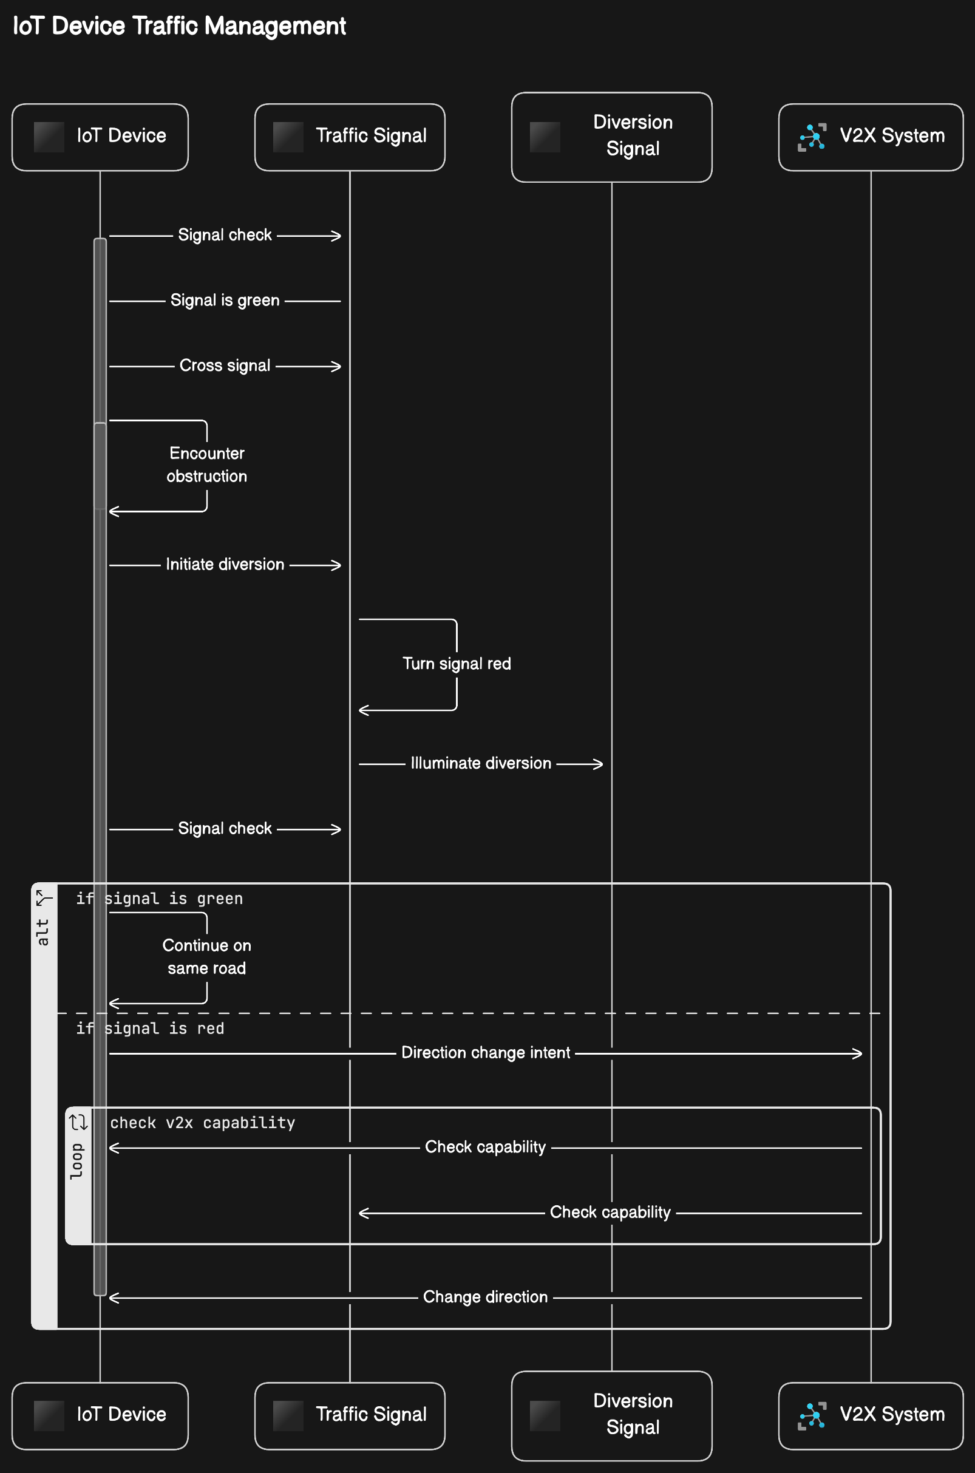
PROPOSED MODULES AND SYSTEM ARCHITECTURE
1.Signal Check Module: Checks if the signal is green or read and showing diversion.
2.V2X capability Module: Checks for V2X compatibility of the devices, if traffic signal shows diversion.
3.Direction Change: Initiates the turning of the V2X device
4.Obstruction Detection: Notifies the traffic signal about the obstruction and turns on the diversion signal.

Slide 21
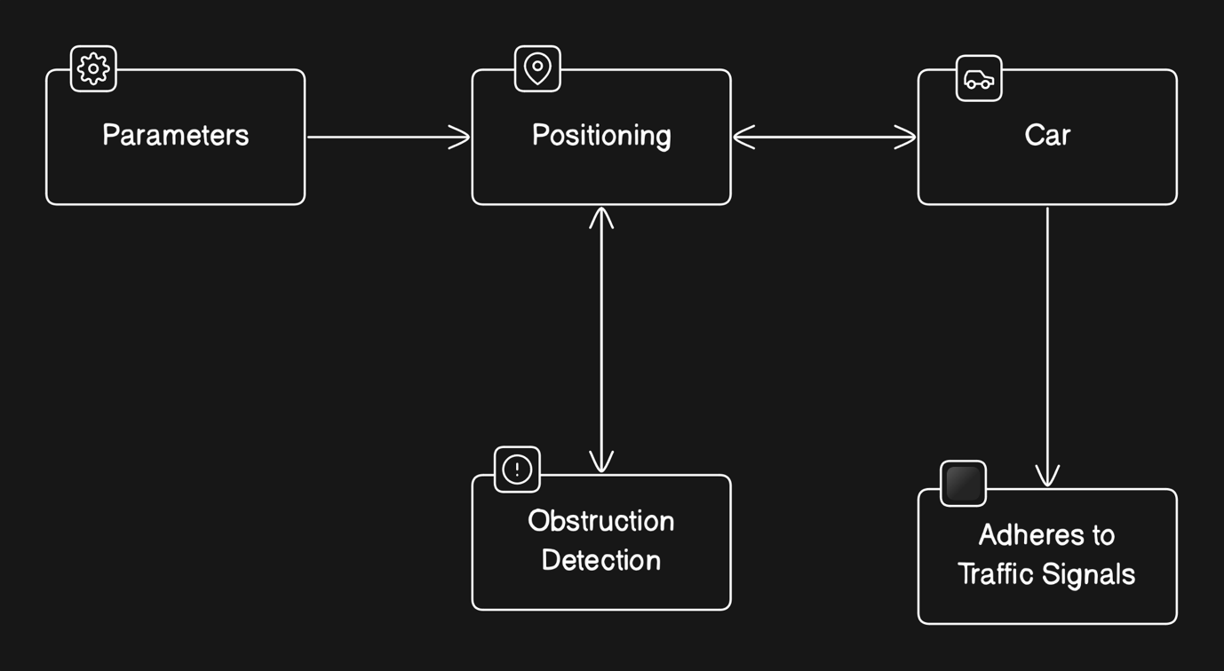
PROPOSED MODULES AND SYSTEM ARCHITECTURE

Slide 22
ALGORITHM DESCRIPTION
The algorithm implements a dynamic scenario of a car navigating a road, considering traffic signal variations and interactions with potential obstructions. It begins by defining parameters such as road length, car speed, and obstacle positions. Initialization involves setting up visualization and control flags, while also initializing parameters for secondary cars. The simulation loop progresses through time steps, updating the initial car's position and checking for obstacles and signal conditions. When an obstruction is detected, the initial car stops, triggering a red signal. Traffic signal conditions dictate it’s behaviour near intersections. Secondary cars are introduced, responding to traffic signals accordingly. Visualization dynamically displays cars, signals, and obstructions, with annotations for clarity. Animation control regulates figure updates and speed. The simulation concludes when the initial car reaches the road's end or a specified time after the later introduced cars stop. Throughout, the script offers a comprehensive portrayal of car dynamics in response to real-world scenarios.

Slide 23
REQUIREMENT GATHERING
Analyzing Systems:
Strengths Of System:
Realism: Accurately reflects real-world traffic scenarios, incorporating dynamic traffic signal changes, obstacle detection, and multi-agent dynamics.
Adaptability: Adaptability to various scenarios and its relevance to real-life traffic conditions make it a valuable tool for urban traffic management research.
Innovation: The integration of dynamic traffic signal color changes based on vehicle proximity showcases innovative approaches to traffic signal control and V2X communication.
Weakness Of System:
Simplified: The simulation may oversimplify certain aspects of urban traffic dynamics, potentially limiting its accuracy in representing complex scenarios.
Dependence On Parameters: The accuracy and effectiveness of the simulation heavily rely on predefined parameters
Scalability: As the complexity of urban traffic scenarios increases, the scalability may become challenging.

Slide 24
REQUIREMENT GATHERING
Legal And Safety Compliances:
Data Protection Regulations: Compliance with data protection regulations s essential if the simulation involves the collection, storage, or processing of personal data.
Intellectual Property Rights: Obtain necessary licenses or permissions for using third-party intellectual property and ensure that the project's code and content do not violate any proprietary rights.
Safety Standards: Adherence to safety standards and regulations applicable to software development and simulations is crucial, as the project involves vehicular safety and traffic management.
Accessibility Guidelines: Compliance with accessibility guidelines, such as the Web Content Accessibility Guidelines (WCAG), ensures that the simulation is accessible to users with disabilities.
Regulatory Requirements: Depending on the jurisdiction, this may include adherence to regulations from transportation authorities, regulatory bodies overseeing software development, and local government regulations concerning traffic simulations and urban planning.

Slide 25
REQUIREMENT GATHERING
Functional Requirements:
Obstruction detection and appropriate response
Traffic signal control based upon predefined conditions
Multi agent dynamics and interactions
Non Functional Requirements:
Performance and capability of handling real time simulation updates with minimum latency
Reliability without crashes and unexpected failures
Usability among various abled persons
Security for the protection of user data
Maintainability with modular architecture and facilities for future enhancements

Slide 26
REQUIREMENT GATHERING
Integration Needs:
Sensor Integration
Traffic Signal Integration
Data Logging and Analytics Integration
Data:
Source: Identifying reliable data sources from government agencies, research institutions, and weather services.
Quality: Ensuring accuracy, completeness, and consistency of acquired data through validation and preprocessing.
Privacy: Adhering to data privacy regulations and implementing encryption and access controls to protect sensitive information.
Storage: Establishing secure storage infrastructure with backup and disaster recovery mechanisms for handling large volumes of data.
Augmentation: Exploring data synthesis and machine learning techniques to enhance the quantity and diversity of available data.

Slide 27
REQUIREMENT GATHERING
Testing And Validation:
Testing involved verifying the responsiveness of obstacle detection logic and traffic signal color changes.
Validation against real-world traffic data ensured the accuracy of the simulation's vehicle behaviors.
Unit testing was conducted to confirm the correctness of individual modules, such as two or more cars were introduced.
Scenario-based testing assessed the simulation's performance under diverse traffic scenarios and signal conditions.
Statistical analysis compared simulation outputs with observed data to evaluate the model's predictive capabilities.
Maintenance And Support:
Maintenance involves regular updates and bug fixes to ensure the software remains functional and efficient.
Support services provide assistance to users in troubleshooting issues and resolving technical problems.
Continuous monitoring helps identify potential issues or performance degradation, allowing for proactive maintenance.
Documentation updates ensure that users have access to the latest information on features, usage, and troubleshooting.
Training programs may be offered to users to enhance their understanding of the software and optimize its utilization.

Slide 28
REQUIREMENT GATHERING
Cost Planning:
Budget allocation involves estimating expenses for development, maintenance, and support phases.
Cost breakdown identifies expenses for personnel, software tools, infrastructure, and miscellaneous expenses.
Contingency funds are reserved to account for unforeseen expenses or scope changes during the project.
Procurement planning includes sourcing vendors or tools required for development and support.
Cost tracking mechanisms are implemented to monitor expenses and ensure adherence to the budget.
Timeline Planning:
Project initiation involves defining objectives, requirements, and scope, typically taking 1-2 months.
Planning phase outlines project milestones, resource allocation, and timelines, lasting 2-3 months.
Development phase entails coding, testing, and integration, typically spanning 3-4 months.
Deployment phase includes rollout of the software and user training, lasting 1-2 months.
Post-deployment support continues indefinitely, with regular updates and maintenance activities.

Slide 29
REQUIREMENT GATHERING
Risk Assessment:
Technical Complexity: The project's technical complexity may pose a risk, particularly in implementing dynamic traffic signal changes and obstacle detection logic accurately.
Data Availability: Insufficient or unreliable real-world traffic data could affect the accuracy of the simulation and validation process, impacting the reliability of the results.
Integration Challenges: Integrating the simulation with existing V2X systems or urban traffic management infrastructure may encounter compatibility issues, leading to delays or functionality limitations.
User Acceptance: User acceptance of the simulation's output and usability may vary, impacting the adoption and effectiveness of the software in real-world applications.
Regulatory Compliance: Ensuring compliance with legal and safety regulations governing traffic simulations and V2X systems is critical to avoid legal liabilities and ensure ethical use of the software.

Slide 30
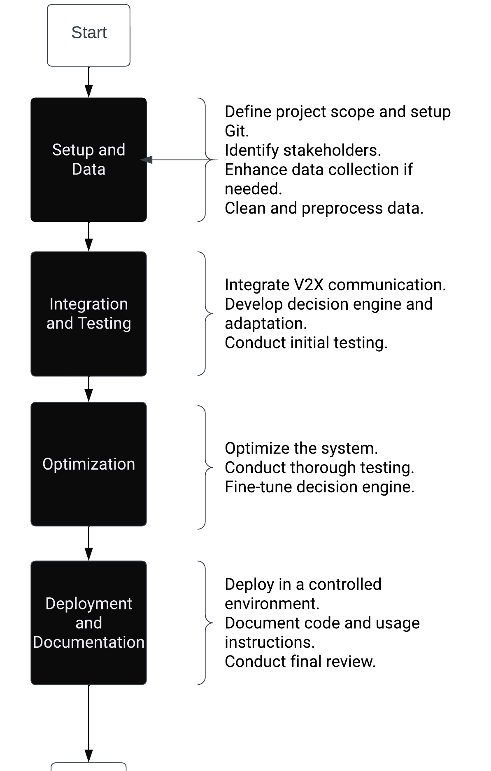
Plan Of Action(POA)

Slide 31
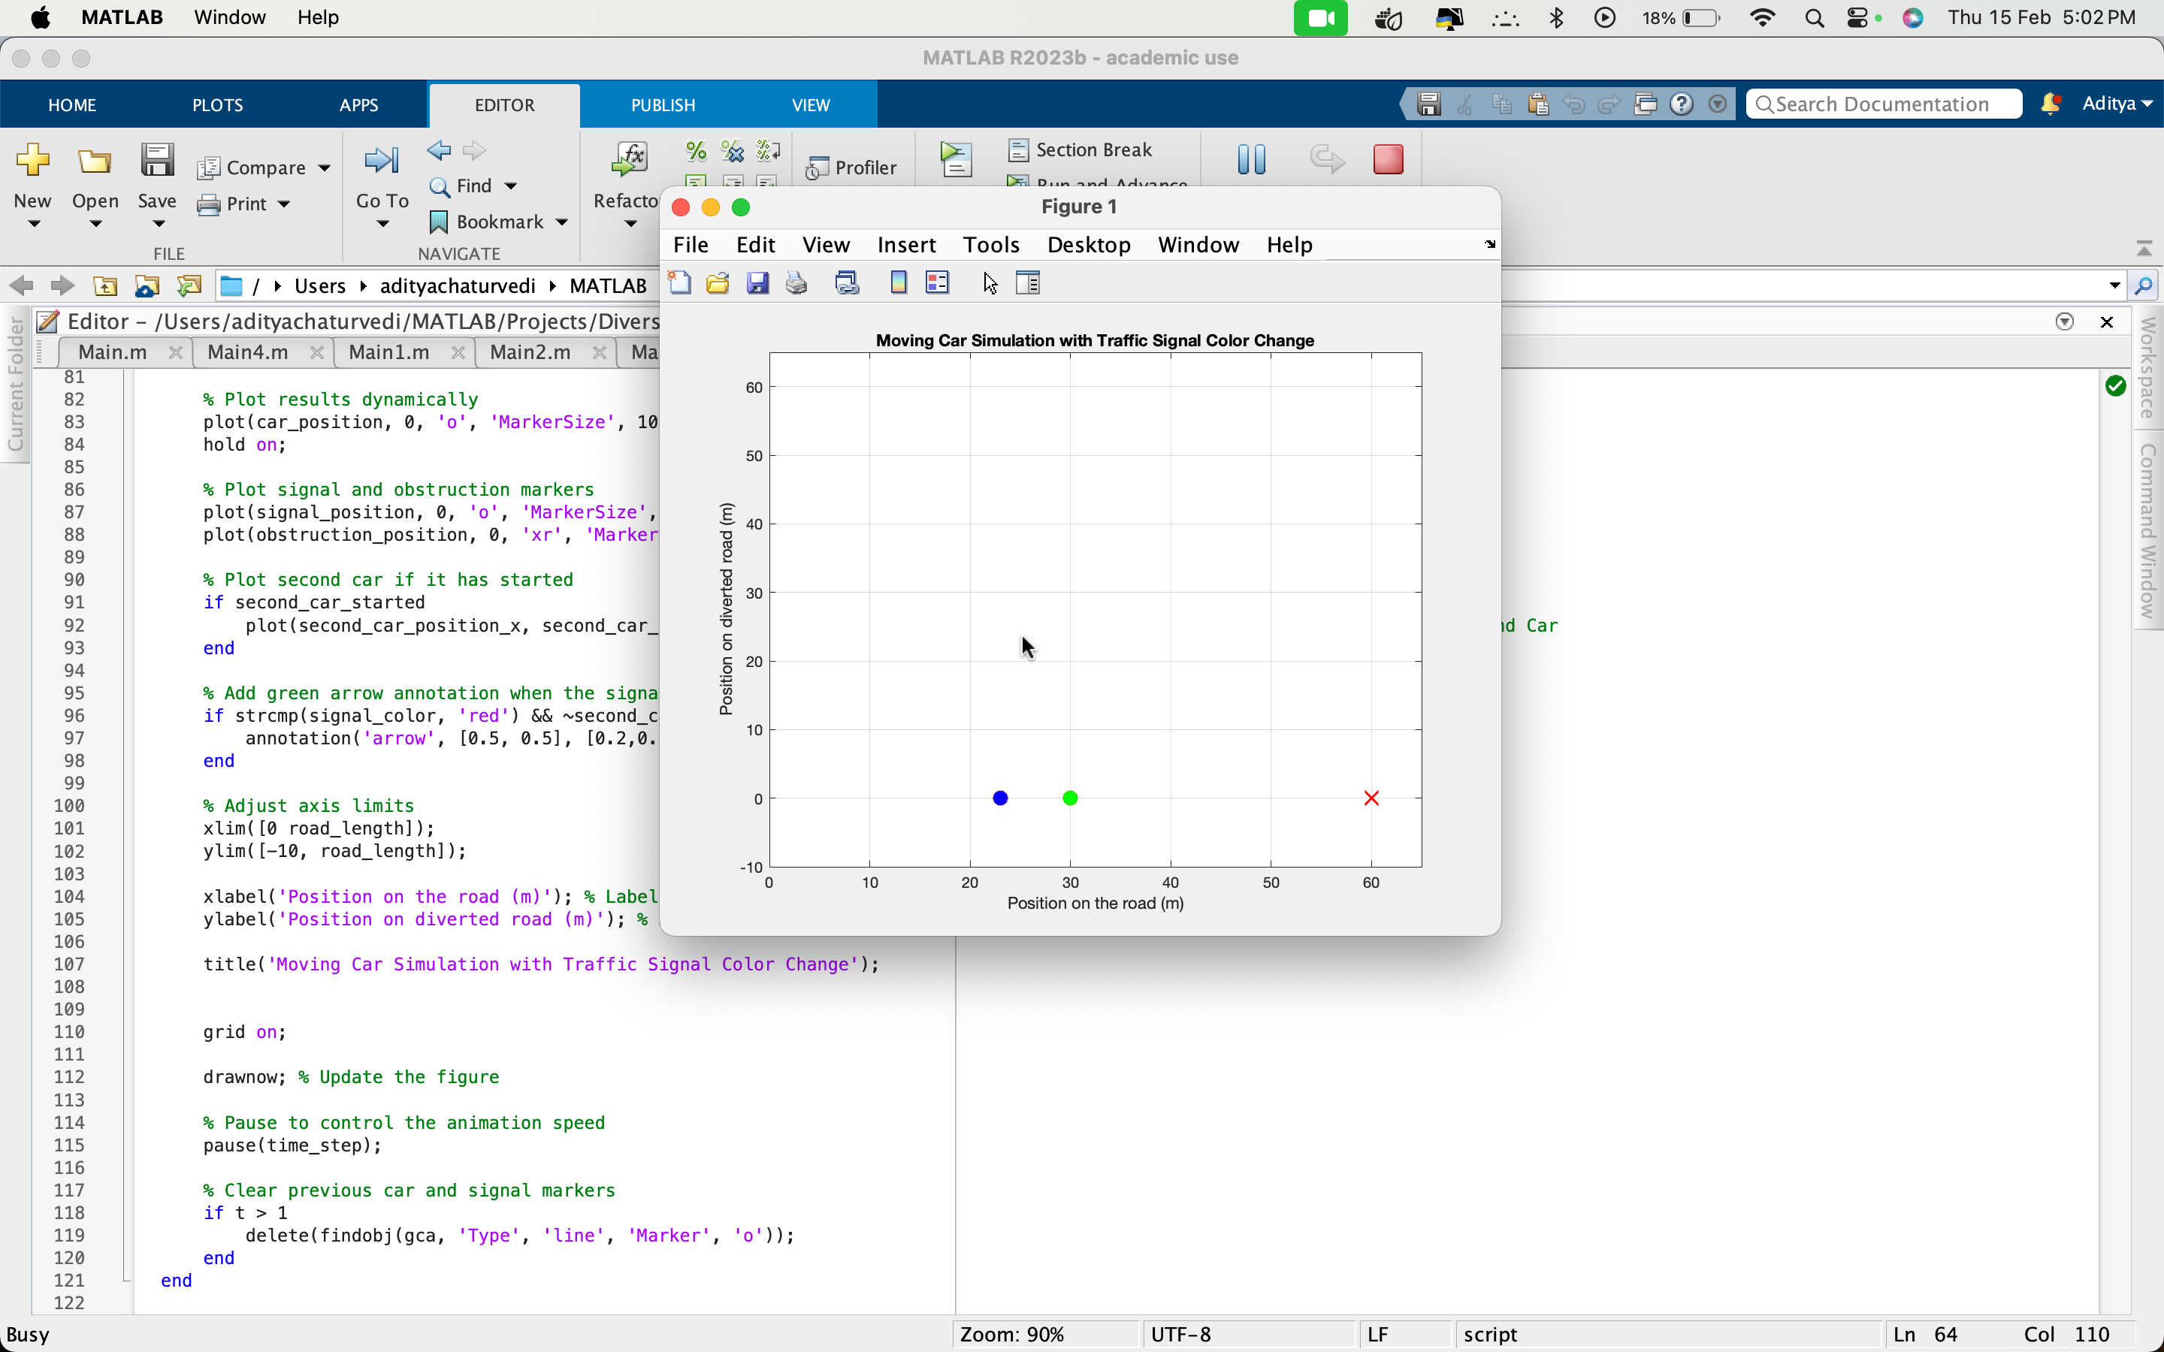
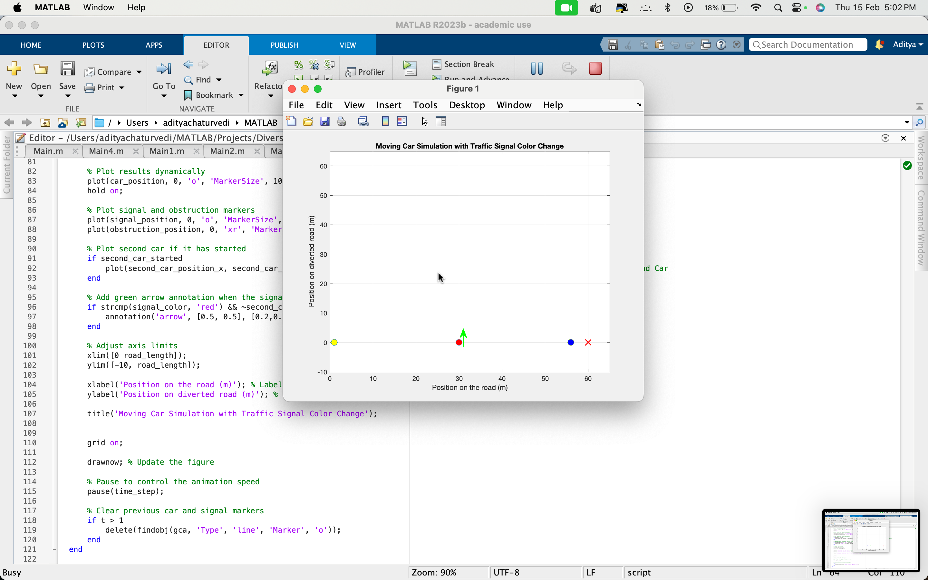

IMPLEMENTATION

Slide 32
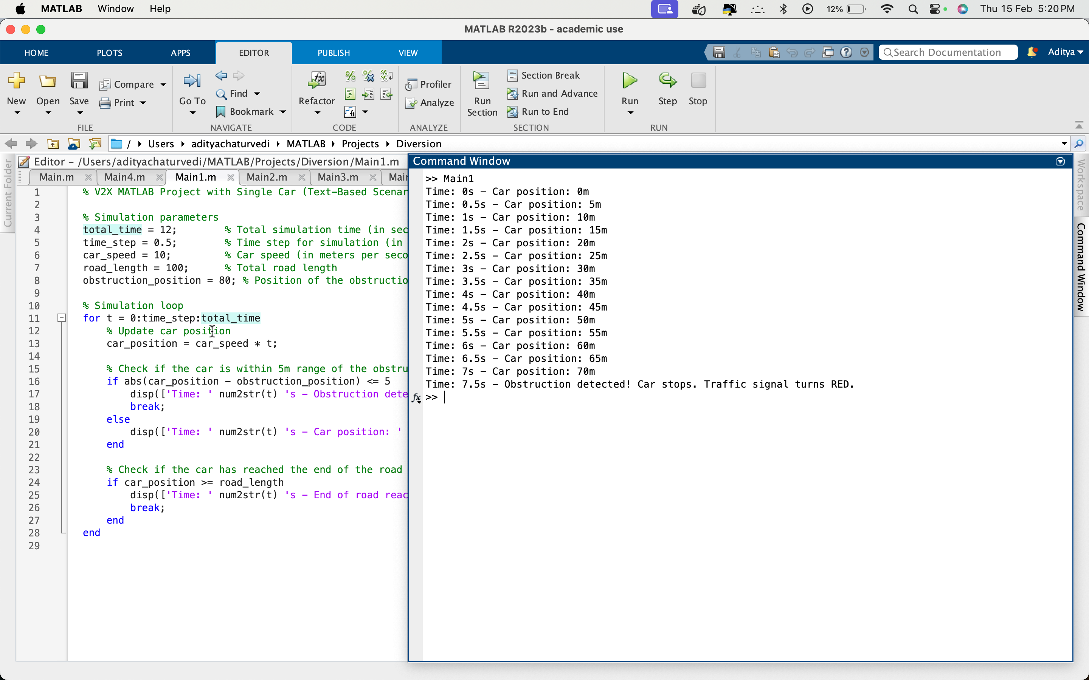
IMPLEMENTATION

Slide 33
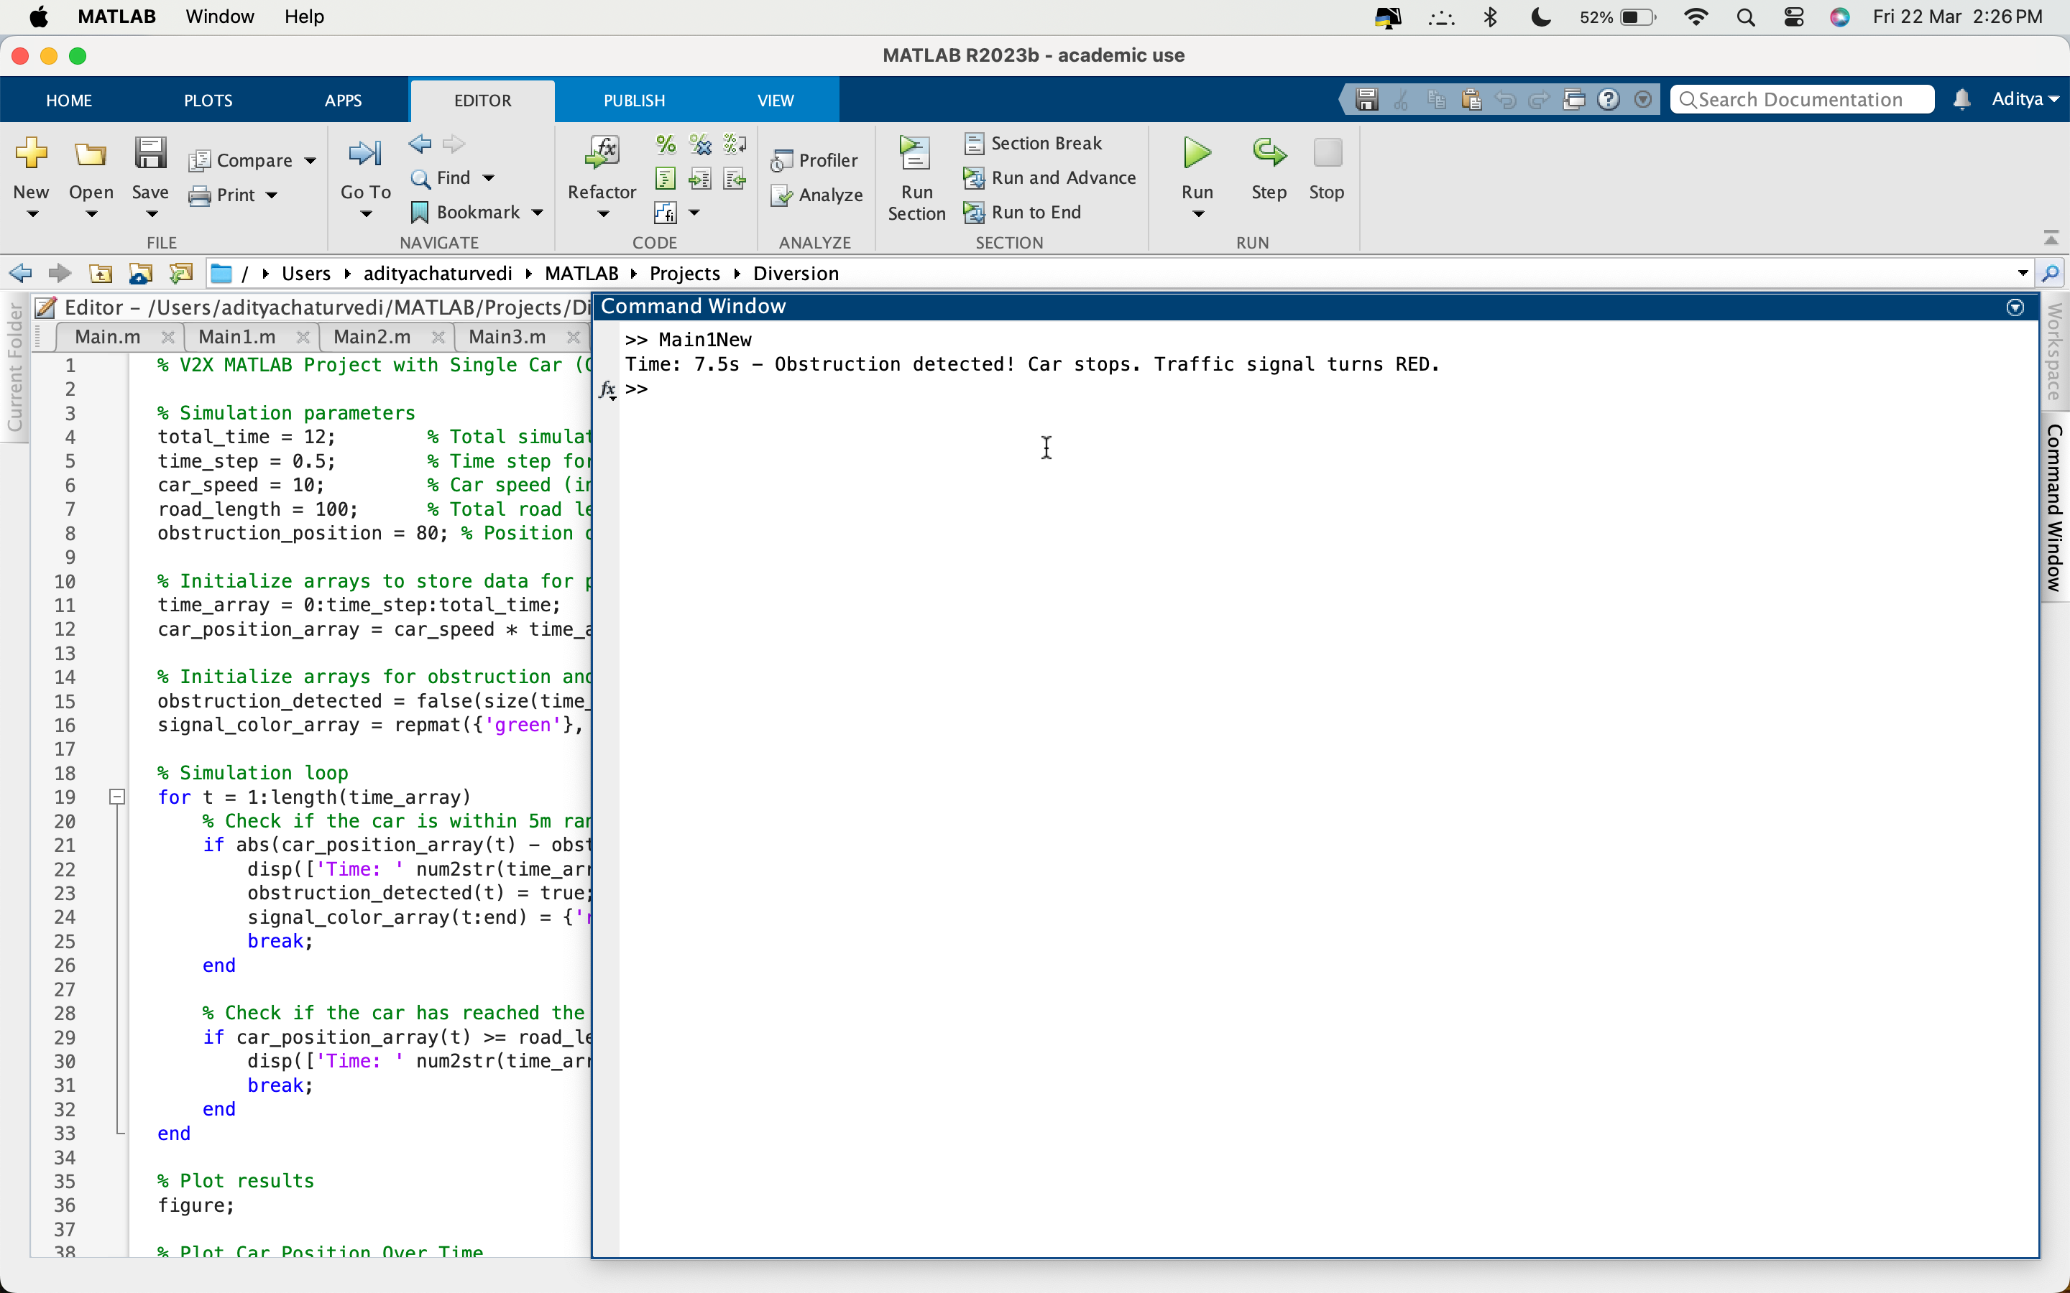
IMPLEMENTATION

Slide 34
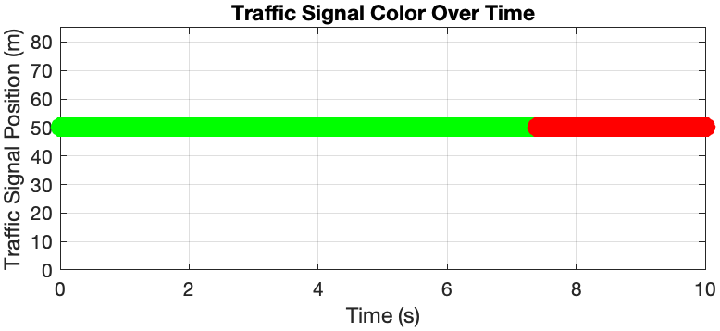
RESULT ANALYSIS

Slide 35
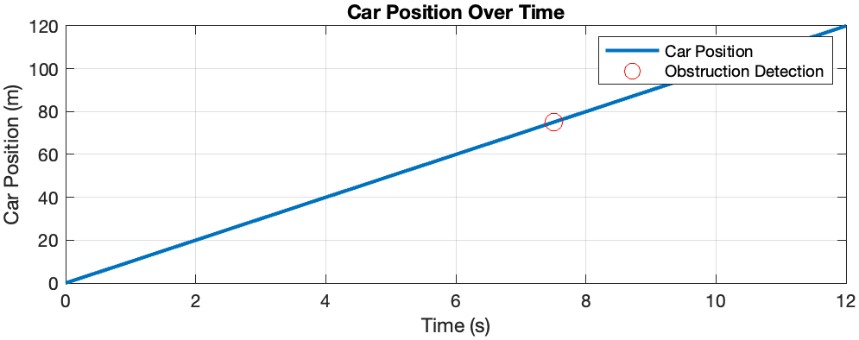
RESULT ANALYSIS

Slide 36
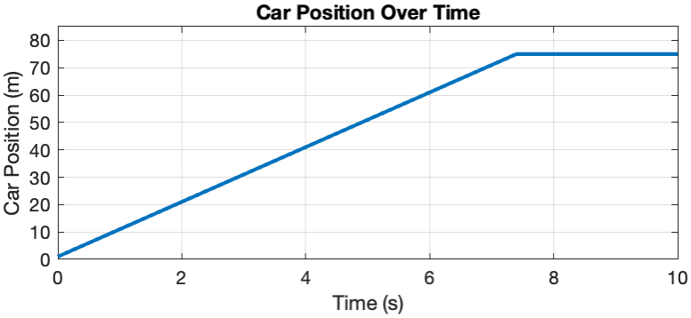
RESULT ANALYSIS

Slide 37
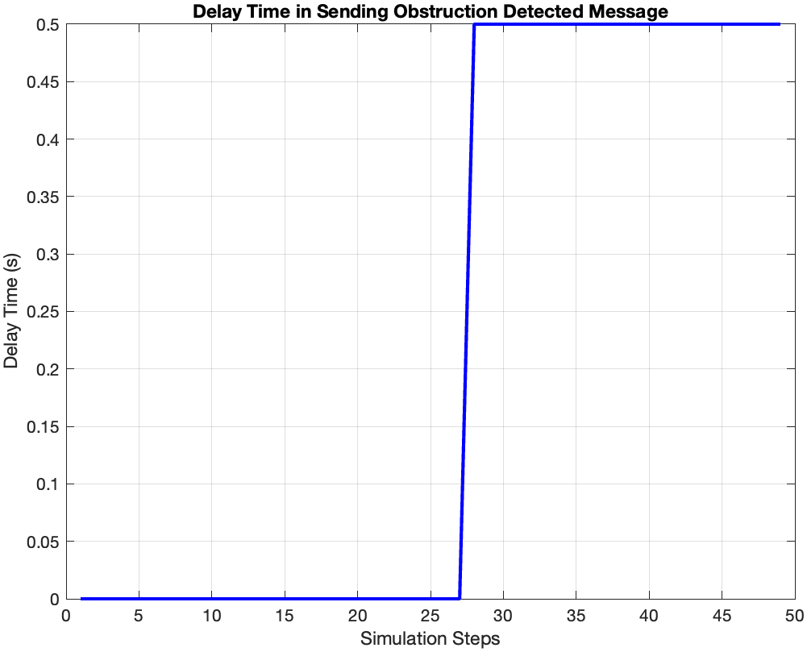
RESULT ANALYSIS

Slide 38
REFERENCE
[1] J. Guo, R. You and L. Huang, Mixed Vertical-and-Horizontal-Text Traffic Sign Detection and Recognition for Street-Level Scene, in IEEE Access, vol. 8, pp. 69413-69425, 2020, https://doi: 10.1109/ACCESS.2020.2986500.
[2] Haiyang Yu, Rui Jiang, Zhengbing He, Zuduo Zheng, Li Li, Runkun Liu, Xiqun Chen, Automated vehicle-involved traffic flow studies: A survey of assumptions, models, speculations, and perspectives, Transportation Research Part C: Emerging Technologies, Volume 127, 2021, 103101, ISSN 0968-090X, https://doi.org/10.1016/j.trc.2021.103101.
[3] Jung C, Lee D, Lee S, Shim DH. V2X-Communication-Aided Autonomous Driving: System Design and Experimental Validation. Sensors. 2020; 20(10):2903. https://doi.org/10.3390/s20102903.
[4] Xun Yang, Yunyang Shi, Jiping Xing, Zhiyuan Liu, Autonomous driving under V2X environment: state-of-the-art survey and challenges, Intelligent Transportation Infrastructure, Volume 1, 2022, liac020, https://doi.org/10.1093/iti/liac020.

Slide 39
REFERENCE
[5] Xiaoyun Xie, Yahya Dorostkar Navaei, Sajad Einy, "A Clustering-Based Routing Protocol Using Path Pattern Discovery Method to Minimize Delay in VANET", Wireless Communications and Mobile Computing, vol. 2023, Article ID 3776815, 18 pages, 2023. https://doi.org/10.1155/2023/3776815
[6] Anh Tuan Giang, Hoang Tung Tran, Huu Ton Le, Nhat Quang Doan, Minh Huong Nguyen, "Jamming Attack in Vehicular Networks: Adaptively Probabilistic Channel Surfing Scheme", Wireless Communications and Mobile Computing, vol. 2022, Article ID 3884761, 8 pages, 2022. https://doi.org/10.1155/2022/3884761
[7] Anh Tuan Giang, Hoang Tung Tran Huu Ton LeNhat Quang Doan Minh Huong Nguyen, “VEHICLE TO EVERYTHING (V2X) COMMUNICATIONS TECHNOLOGY FOR SMART MOBILITY” https://doi.org/10.35741/issn.0258-2724.56.4.47
[8] Sharjeel Masood, Fawad Ahmed, Suliman A. Alsuhibany, Yazeed Yasin Ghadi, M. Y. Siyal, Harish Kumar, Khyber Khan, Jawad Ahmad, "A Deep Learning-Based Semantic Segmentation Architecture for Autonomous Driving Applications", Wireless Communications and Mobile Computing, vol. 2022, Article ID 8684138, 12 pages, 2022. https://doi.org/10.1155/2022/8684138

Slide 40
REFERENCE
[9] Lu, Qiang & Jung, Hojin & Kim, Kyoung-Dae. (2021). An Optimization-based Approach for Resilient Connected and Autonomous Intersection Crossing Traffic Control under V2X Communication. IEEE Transactions on Intelligent Vehicles. 7. 1-1. 10.1109/TIV.2021.3133841.
[10] Haiyang Yu, Rui Jiang, Zhengbing He, Zuduo Zheng, Li Li, Runkun Liu, Xiqun Chen, Automated vehicle-involved traffic flow studies: A survey of assumptions, models, speculations, and perspectives, Transportation Research Part C: Emerging Technologies, Volume 127, 2021, 103101, ISSN 0968-090X, https://doi.org/10.1016/j.trc.2021.103101.
[11] Jung C, Lee D, Lee S, Shim DH. V2X-Communication-Aided Autonomous Driving: System Design and Experimental Validation. Sensors. 2020; 20(10):2903. https://doi.org/10.3390/s20102903
[12] Syed Adnan Yusuf Arshad Khan Riad Souissi, “Vehicle-to-Everything (V2X) Communication Approach Towards Advanced Intelligent Transportation”. https://doi.org/10.35741/issn.0258-2724.56.4.47

Slide 41
REFERENCE
[13] Haokun Song, Fuquan Zhao, Guangyu Zhu, Zongwei Liu, "Impacts of Connected and Autonomous Vehicles with Level 2 Automation on Traffic Efficiency and Energy Consumption", Journal of Advanced Transportation, vol. 2023, Article ID 6348778, 15 pages, 2023. https://doi.org/10.1155/2023/6348778
[14] Kavas-Torris O, Gelbal SY, Cantas MR, Aksun Guvenc B, Guvenc L. V2X Communication between Connected and Automated Vehicles (CAVs) and Unmanned Aerial Vehicles (UAVs). Sensors (Basel). 2022;22(22):8941. Published 2022 Nov 18. https://doi:10.3390/s22228941
[15] Dhawankar P, Agrawal P, Abderezzak B, Kaiwartya O, Busawon K, Raboacă MS. Design and Numerical Implementation of V2X Control Architecture for Autonomous Driving Vehicles. Mathematics. 2021; 9(14):1696. https://doi.org/10.3390/math9141696

Slide 42
REFERENCE
[16] Guilherme Carrenho, “Enhancing Transportation with Vehicle-to-Everything (V2X) Communication”. Innovation Expert at Encora.
[17] Guo, Jiaying & Cheng, Long & Wang, Shen. (2023). CoTV: Cooperative Control for Traffic Light Signals and Connected Autonomous Vehicles Using Deep Reinforcement Learning. IEEE Transactions on Intelligent Transportation Systems. PP. 1-12. 10.1109/TITS.2023.3276416.
[18] Ahangar MN, Ahmed QZ, Khan FA, Hafeez M. A Survey of Autonomous Vehicles: Enabling Communication Technologies and Challenges. Sensors. 2021; 21(3):706. https://doi.org/10.3390/s21030706
[19] Manzoor Ahmed Khan, Hesham El Sayed, Sumbal Malik, Talha Zia, Jalal Khan, Najla Alkaabi, and Henry Ignatious. 2022. Level-5 Autonomous Driving—Are We There Yet? A Review of Research Literature. ACM Comput. Surv. 55, 2, Article 27 (February 2023), 38 pages. https://doi.org/10.1145/3485767

Slide 43
REFERENCE
[20] Zekun Cai and Aiping Xiong. 2023. Understand users' privacy perception and decision of V2X communication in connected autonomous vehicles. In Proceedings of the 32nd USENIX Conference on Security Symposium (SEC '23). USENIX Association, USA, Article 167, 2975–2992.
[21] I. Finkelberg et al., "The Effects of Vehicle-to-Infrastructure Communication Reliability on Performance of Signalized Intersection Traffic Control," in IEEE Transactions on Intelligent Transportation Systems, vol. 23, no. 9, pp. 15450-15461, Sept. 2022, https://doi: 10.1109/TITS.2022.3140767.
[22] Backfrieder, C. (2018). Traffic efficiency optimization through V2X communication [Dissertation, Technische Universität Wien]. reposiTUm. https://doi.org/10.34726/hss.2018.54646
[23] Movil, Kathrein, Mavenir (2018). “Cellular V2X Communications Towards 5G”. 5G Americas.

Slide 44
REFERENCE
[24] Cheung, Y., Qiu, M., Liu, M. (2019). Autonomous Vehicle Communication in V2X Network with LoRa Protocol. In: Qiu, M. (eds) Smart Computing and Communication. SmartCom 2019. Lecture Notes in Computer Science(), vol 11910. Springer, Cham. https://doi.org/10.1007/978-3-030-34139-8_40
[25] Natsuki UEHARA, Kenya SATO (2022). V2X Communication Congestion Control Method based on Vehicle Flow Management. Computer and Information Science, Graduate School of Science and Engineering, Doshisha University, Kyoto, Japan. https://doi.org/ 10.14988/00028928
[26] G. Bendiab, A. Hameurlaine, G. Germanos, N. Kolokotronis and S. Shiaeles, "Autonomous Vehicles Security: Challenges and Solutions Using Blockchain and Artificial Intelligence," in IEEE Transactions on Intelligent Transportation Systems, vol. 24, no. 4, pp. 3614-3637, April 2023, https://doi: 10.1109/TITS.2023.3236274.
[27] Al-Turki M, Ratrout NT, Rahman SM, Reza I. Impacts of Autonomous Vehicles on Traffic Flow Characteristics under Mixed Traffic Environment: Future Perspectives. Sustainability. 2021; 13(19):11052. https://doi.org/10.3390/su131911052
[28] Hobert, Laurens & Festag, Andreas & Llatser, Ignacio & Altomare, Luciano & Visintainer, Filippo & Kovacs, Andras. (2015). Enhancements of V2X Communication in Support of Cooperative Autonomous Driving. IEEE Communications Magazine. 53. 64-70. 10.1109/MCOM.2015.7355568.

Slide 45
REFERENCE
[29] Dai, Y., Yang, Y., & Zhong, H. (2023). Impact of Platoon Management on Heterogeneous Traffic under V2X Communication Limitation. Transportation Research Record, 2677(5), 1100-1119. https://doi.org/10.1177/03611981221140365
[30] Tiancheng Ruan, Linjie Zhou, Hao Wang, Stability of heterogeneous traffic considering impacts of platoon management with multiple time delays, Physica A: Statistical Mechanics and its Applications, Volume 583, 2021, 126294, ISSN 0378-4371, https://doi.org/10.1016/j.physa.2021.126294

